Slide 1
E3
by Infinity Eight

Slide 2
Infinity Eight
Introduction
Topics Covered (in order from team list)
Studios: BioWare, Cloud Imperium, Avalanche Studios, Frogwares
Relevance
Introduction
Anveer’s topic
Sebastian’s topic Bethesda
Ronin’s topic
Ethan’s topic
Hartion’s topic
Team
Ivan Kravchenko
Samatar Sulieman
Ramin (Roma) Amiri
Anveer Rai
Sebastian Nienajadlo
Ronin Kornelsen
Ethan Williams
Hartion Antraneek

Slide 3
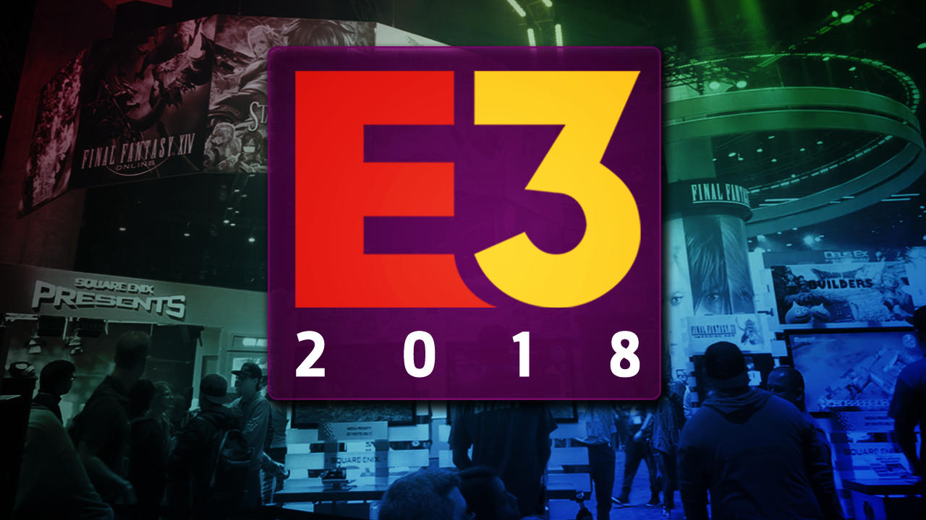


Intro - Roma Amiri
E3 stands for Electronic Entertainment Expo.
Organized by Entertainment Software Association (ESA).
A few days before the event, largest publishers showcase the offerings that will be on display in an hour-long conference.
Formally an industry-only event.
E3 became open to the public starting 2017.
Since 2009, the event was held in Los Angeles.
Event is usually held in the second week of June.

Slide 4

History
The very first E3 ever held was in 1995 and it has been 22 years since then.
Every year the event is usually held in Los Angeles Convention Centre. Except for
It is run by the ESA (Entertainment Software Association)
The first ever E3 had over 50,000 attendees in 1995.
In 2007 the ESA wanted to downsize the event and made it a much smaller audience size. But reverted back to large scale in 2009.
2017 was the first year e3 was open to the public and consumers were allowed to purchase tickets to the event.

Slide 5
Relevance - Sam
E3 is important and relevant to a lot of different groups, companies and individuals for a variety of reasons.
It lets publishers, developers, producers to network and have meetings with retail stores and other international companies.
It lets consumers see why they should buy the various games and decide for themselves what looks good and what doesn't.
It lets smaller indie companies and game developers a platform to showcase there game in the best way, so to compete with the larger companies like Rockstar and bethesda

Slide 6


The Sinking City
Release: March 21, 2019
Developed by Frowares and published by Bigben Interactive
The Sinking City takes place in Oakmont, Massachusetts, which is experience unprecedented flooding. You play as a private investigator attempting to find the disaster’s source, only to discover that something is controlling the minds of residents

Slide 7


Just Cause 4 brings back hero agent Rico Rodriguez and his grappling hook and sets them loose in the fictional South America country of Solis
The game features massive destruction, and over the top action.
You're fighting The Black Hand again, but this time you're in their world, so they have home advantage.
Genre: Action-adventure
Developed by Avalanche Studios and published by Square Enix
Just Cause 4 will release on December 4, 2018, on PS4, Xbox One, and PC

Slide 8
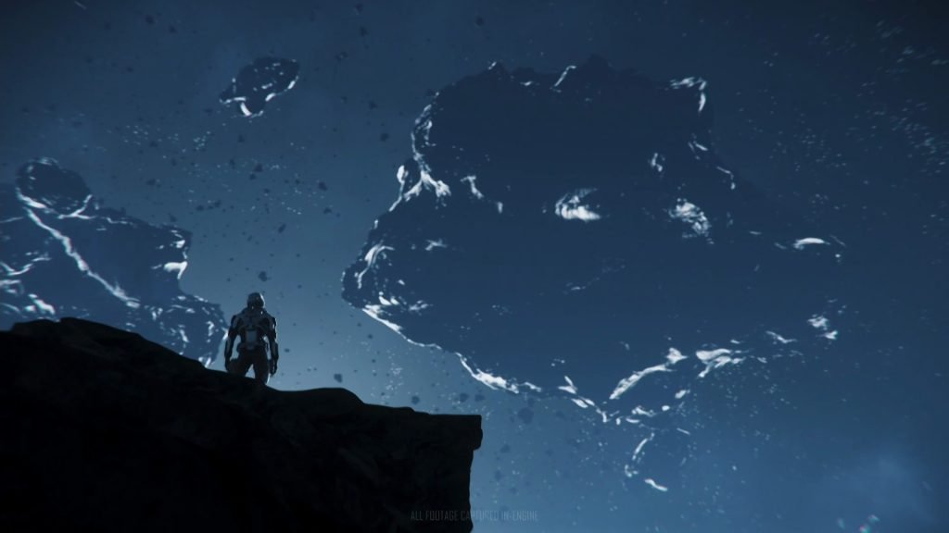

Star Citizen
Alpha 3.2
Star Citizen is an upcoming massively multiplayer, space trading and combat game developed and published by Cloud Imperium Games for Microsoft Windows.
The Alpha 3.2 update for Star Citizen will be coming soon. We were treated to a montage of players on foot, in ships, and in massive carrier ships in space and in the atmosphere. We got to see a variety of settings from the game and a few different scenarios including ground combat, space combat, and tranquil exploration on foot and in ships.

Slide 9


Cyberpunk 2077- Ethan
CyberPunk 2077
being developed by CD Projekt Red, the creators of The Witcher series.
Release: No current release date
Genre: RPG
Cyberpunk 2077 is an open world RPG set in a fictional city known as Night City.
The game is played through the eyes of V who is fully created and customized by the player. CD Projekt Red have released a gameplay walkthrough of a small part of the game showing how it looks in its current state.

Slide 10


Slide 11


Battlefield 5
Taking place in WW2
The announcement stated it will feature "core pillars of destruction, team play, and vehicles," and will be"unlike anything you’ve played before."
Developed by EA Dice
The next in the series of the popular franchise
Jumping on the bandwagon a battle royale mode has been Announced

Slide 12
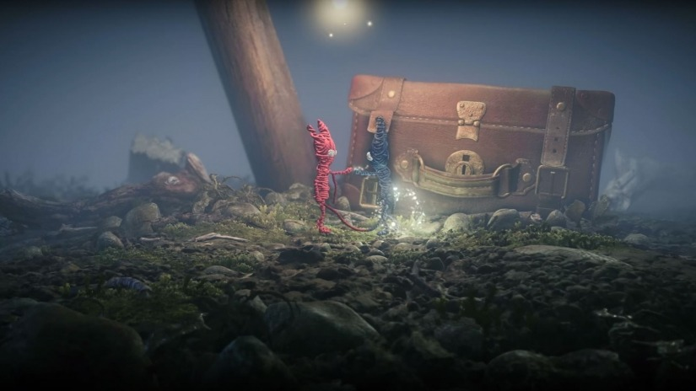

Unravel 2
Developed by ColdWood Interactive
The sequel for the original puzzle platformer
“Play as a pair of Yarnys – small beings made of yarn and connected by a single thread – in local co-op or as a single player. Run, jump and swing through platforming puzzles, foster friendship, and shed light on a world covered in shadow.”

Slide 13


Sea of solitude
Developed by Jo-Mei Games
Sea of Solitude is an upcoming adventure video game developed by Jo-Mei Games and published by Electronic Arts. The player controls a young woman named Kay as she explores an abandoned, submerged city and its creature in order to reveal why Kay herself has turned into a monster.
A stunning indie adventure game in a city based on Berlin, Germany

Slide 14


Anthem
being developed by BioWare and published by Electronic Arts.
Release: March 2019
Genre: shared-world action RPG
EA is describing it as:
“shared-world action RPG Freelancers challenge the wilds past the wall, exploring a vast world filled with savage beasts and ruthless marauders, but also teeming with amazing technology and forgotten treasures”

Slide 15


Slide 16
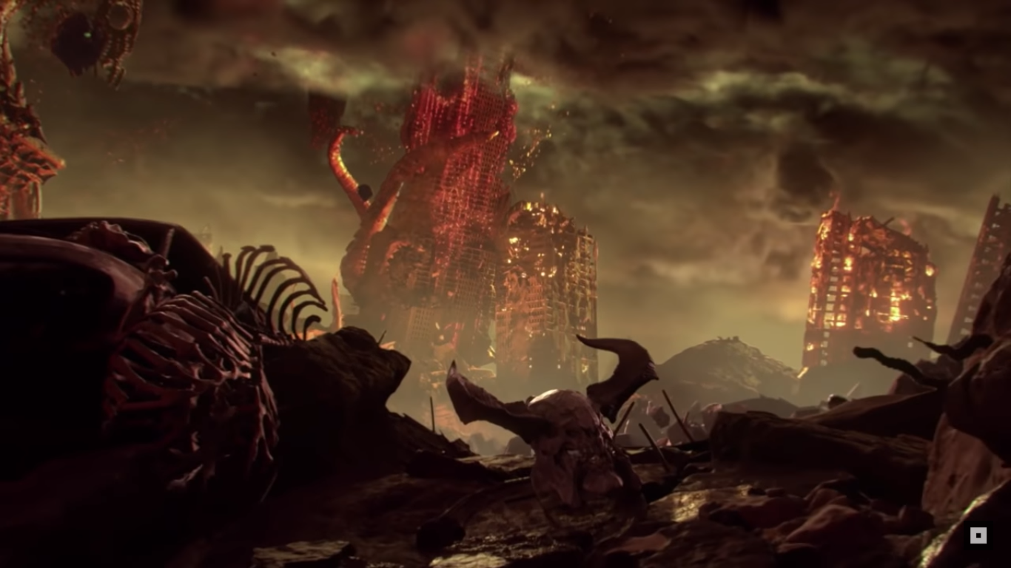

DOOM Eternal
Doom was shown during E3 with a suspenseful trailer of a world dominated by tentacles everywhere (Cthulhu XD) and a lot of spooky monsters that will get demolished.
Genre - First person shooter

Slide 17
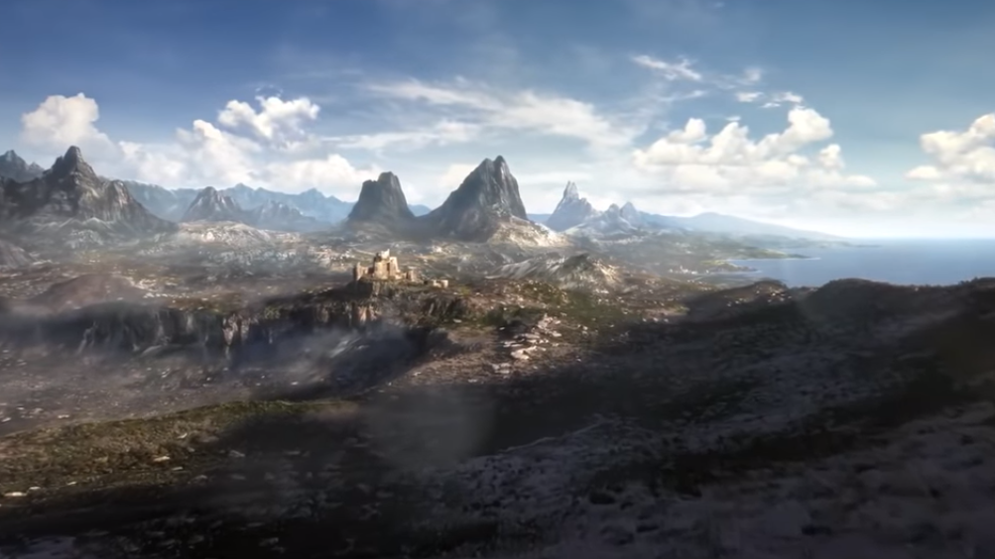
The Elder Scrolls 6
The elder scrolls 6 is confirmed and it will have new mobile capabilities. The game will have combat on mobile devices that you can play against your friends.
Genre - RPG

Slide 18

Ubisoft

Slide 19

STARLINK: BATTLE FOR ATLAS
Flatforms - Xbox One, PS4, Switch
Price - Standard $79.99, $99.99 Starter Edition, $106.49 Deluxe Edition (Xbox One, PS4, Switch)
Release Date - October 16, 2018
Editions - Starter Edition (Physical, Digital) Deluxe Edition (Digital)
Genre - Action-adventure
Description - Starlink: Battle for Atlas is a new action-adventure game where you assemble a custom Starship model mounted to your game controller to launch into an interplanetary adventure. Lead a group of heroic interstellar pilots who use modular starships to mix and match their unique gear and skills on the fly. Travel the stars to unite the galaxy against villainous destructive forces.

Slide 20

Trials Rising
Flatforms - Xbox One, PS4, Switch, PC
Price - Standard $20.99 (PC), $29.99 Gold Edition (Xbox One, PS4, Switch, PC)
Release Date - February 2019
Editions - Standard Edition (PC) Gold Edition (Xbox One, PS4, Switch, PC)
Genre - Racing
Description - Trials Rising is an upcoming multiplayer 2.5D racing game developed by RedLynx and Ubisoft Kiev and published by Ubisoft. It will be the first mainline entry in the Trials series since 2014's Trials Fusion.

Slide 21

Beyond Good & Evil 2
Flatforms - Unknown
Price - Unknown
Release Date - Unknown
Editions - Unknown
Genre - Action-adventure
Description - Beyond Good and Evil 2 is an action-adventure game set in an open world environment and played from a third-person perspective which takes place at least one generation prior to the events of Beyond Good & Evil. It has more traditional role-playing elements compared to the first game; the player generates a character that starts the game at the very bottom of the social system.

Slide 22

Tom Clancy’s The Division 2
Flatforms - Xbox One, PS4,Switch (Japan Only), PC
Price - Standard $20.99 (PC), $29.99 Gold Edition (Xbox One, PS4, Switch, PC)
Release Date - March 15, 2019 (Initial release date)
Editions - Standard Edition, Dark Zone Definitive Collector, Phoenix Shield Collector (Xbox One, PS4, PC)Gold Edition Ultimate Edition (PC)
Genre - Action role-playing game, Survival game
Description - Played from a third-person perspective, the game takes place 7 months after its predecessor in Washington D.C., in which a civil war between survivors and villainous bands of marauders breaks out.[1] In the game, players can cooperate with each other to complete objectives. The game will also feature raids, which can be completed by up to 8 players

Slide 23

Assassin’s Creed Odyssey
Flatforms - Xbox One, PS4, PC,
Price - $59.99 Standard, $159.99 Spartan Collector, $219.99 Pantheon Collector (Xbox One, PS4, PC), $79.99 Digital Deluxe Edition, $99.99 Gold Edition, $119.99 Ultimate Edition (PC)
Release Date - October 5,2018
Editions - Standard Edition, Spartan Collector, Pantheon Collector (Xbox One, PS4, PC) Digital Deluxe Edition, Gold Edition, Ultimate Edition (PC)
Genre - Action role-playing, stealth
Description - Write your own epic odyssey and become a legendary Spartan hero. Forge your destiny in a world on the brink of tearing itself apart. Influence how history unfolds in an ever-changing world shaped by your choices.

Slide 24

Microsoft - Ronin

Slide 25
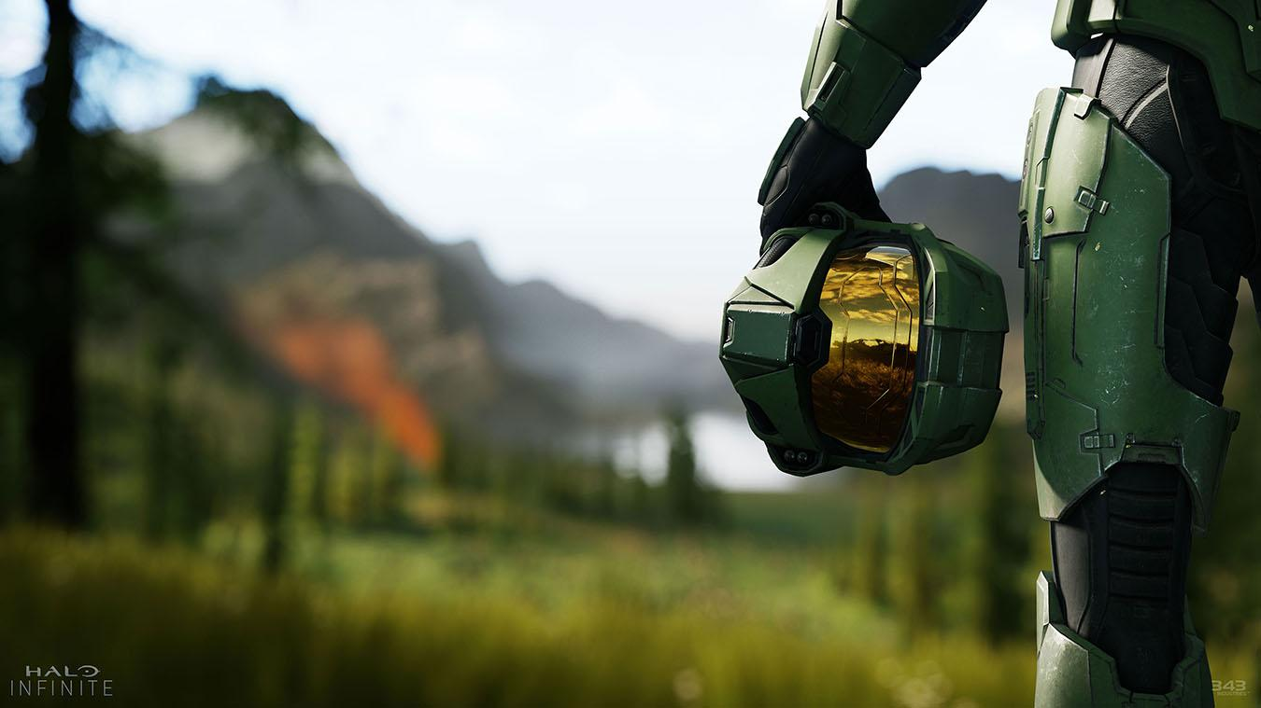

Halo Infinite
Being developed by 343 Industries.
The Demo shown during the 2018 conference was a tech demo to show the capabilities of the Slipspace engine.
Story picks up directly after Halo 5: Guardians.

Slide 26


Sekiro: Shadows Die Twice
Being developed by FromSoftware and being lead by Hidetaka Miyazaki.
Despite being the newest game from FromSoftware since Dark Souls 3, Sekiro is more related to Tenchu, a Japanese IP that FromSoftware had acquired the rights for.
It will be released March 22nd, 2019

Slide 27


Kingdom Hearts 3
Being developed by Square Enix.
The third game in the Kingdom Hearts series.
Slated for release on January 29th, 2019.

Slide 28


Future
Gears 5
Being developed by The Coalition and published by Microsoft Studios.
The fifth game in the series, and middle installment in the second trilogy.
Release Date: 2019

Slide 29
The Future of E3
This year's E3 was huge and had 2.5 million viewers on Twitch and 97.6 million views in total.
Viewership was up 71% more than last year and the total minutes that were watched doubled the amount that was watched last year.
These stats show that E3 is growing and more people are excited for the future of gaming as well as the future of E3 itself.

Slide 30


Slide 31
References
fortune.com/2018/06/26/e3-2018-twitch-streaming/ - used in slide 29

